Slide 1


Slide 2
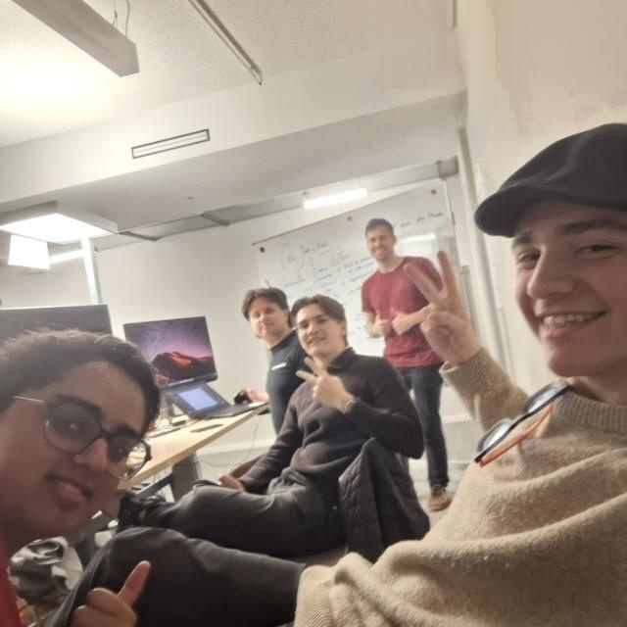


The Team
meet the bobbies

Slide 3

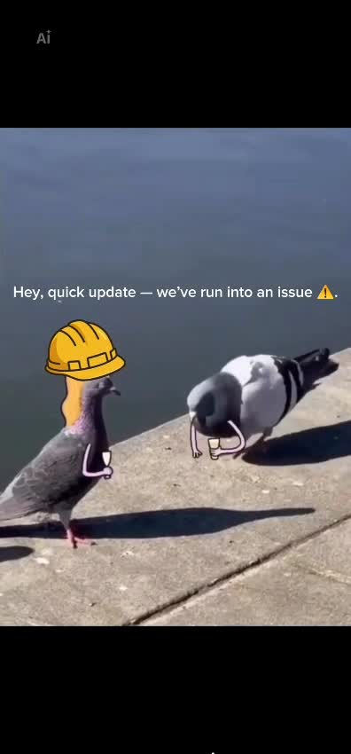

PROBLEM

Slide 4
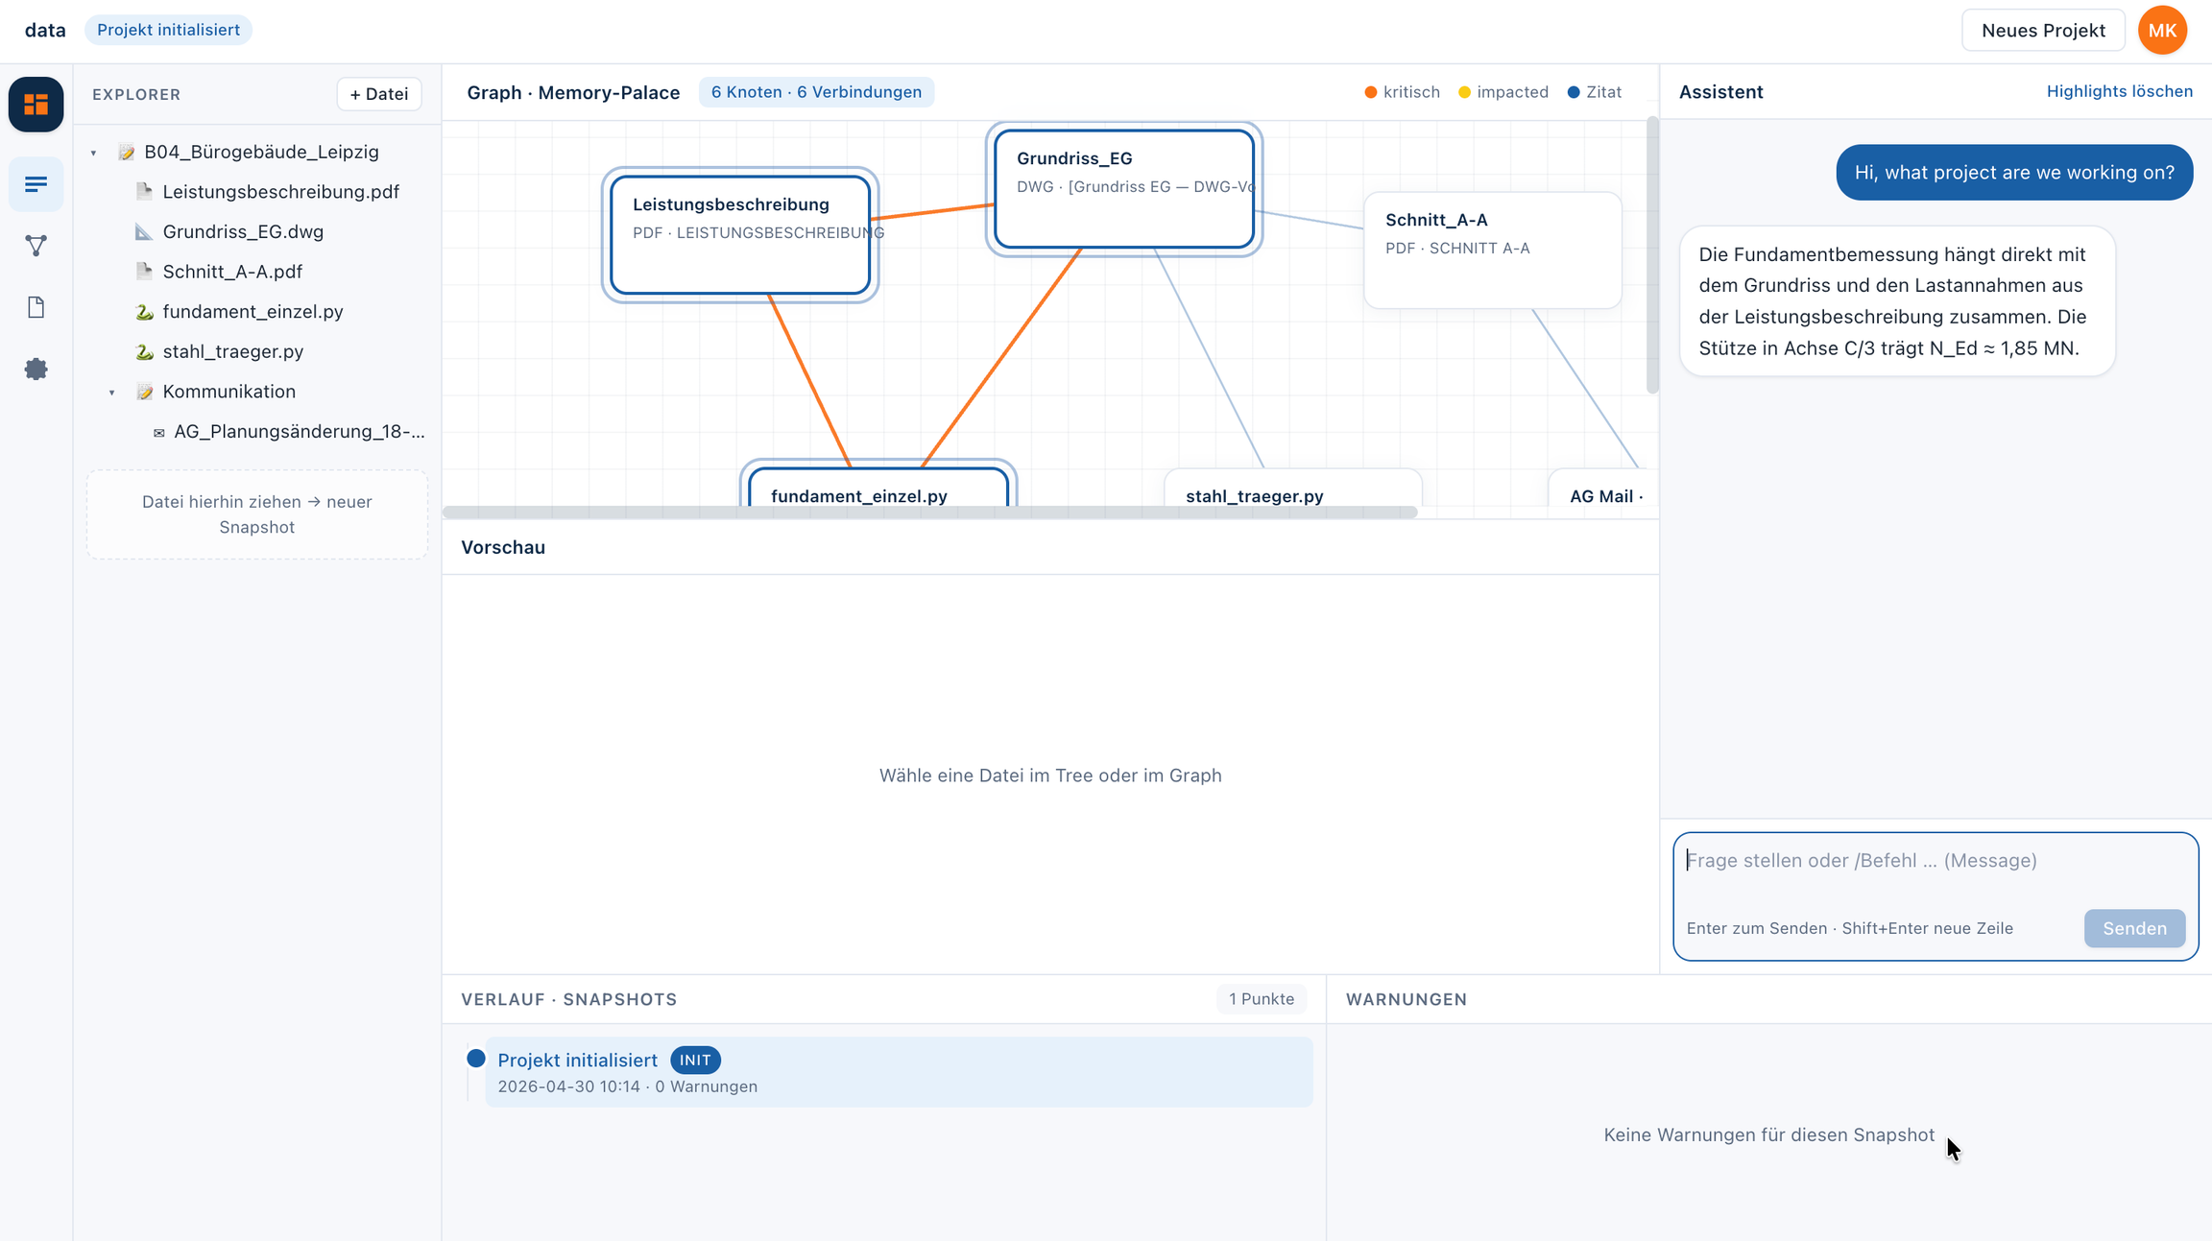
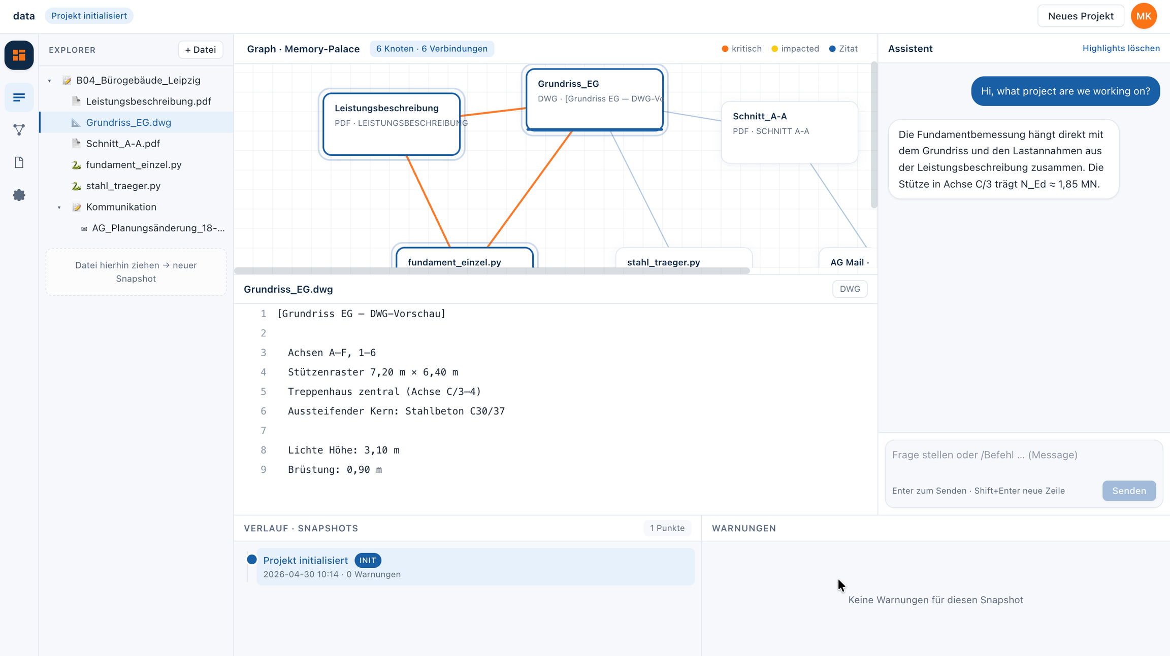

Slide 5
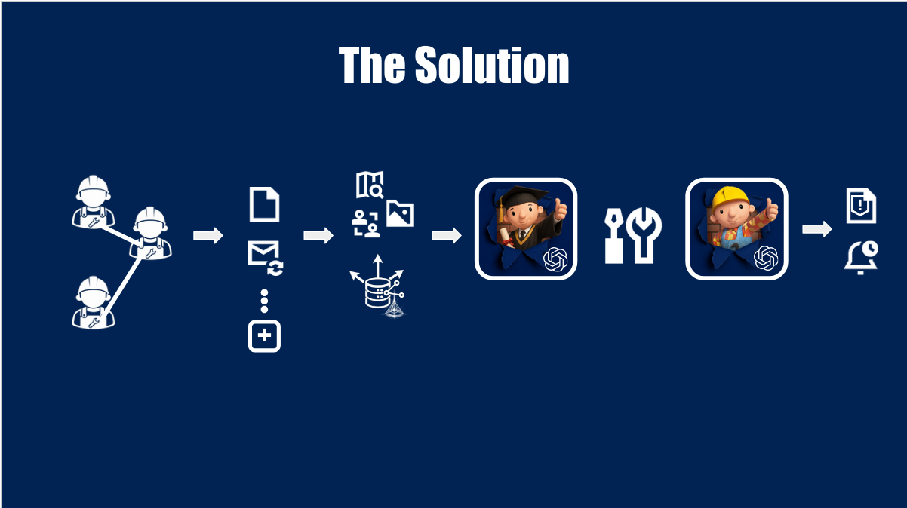

Slide 6








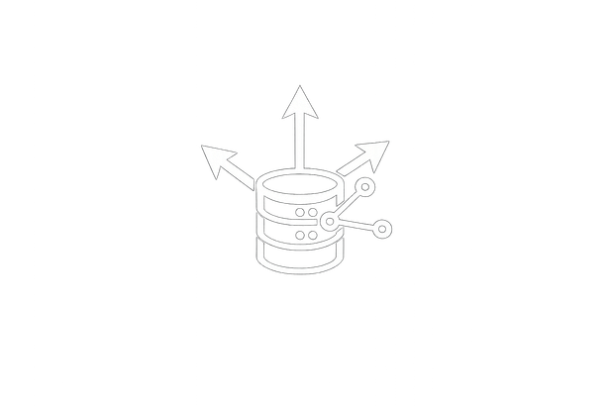




Agentic Interaction in Detail:
Input
Backend
Chatbot
+
Email updates
Docs updates
Communication
Inputs & guidelines
Formulas & simulations
Outcomes & notifications
Ask
Develop
Notify

Slide 7
Thank you!

